Slide 1
Name | James
Git Hash | f0cc35dd3a8cfb1d7bee623bf8f55deddab5ad80
Sprint number | Start date | end date | Work hard rating
6 | 27/6/2022 | 8/7/2022 | 4/5

Slide 2
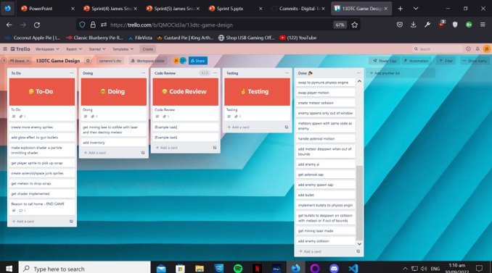
KANBAN board at the start of the sprint

Slide 3
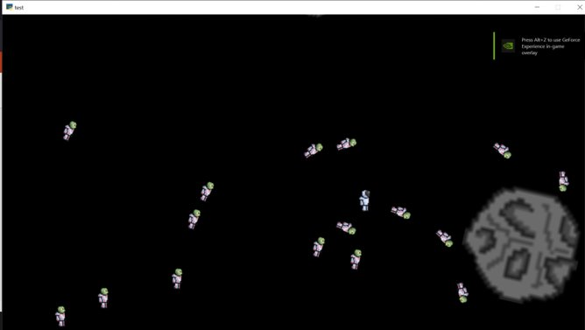
Screenshot of the game at the start of the sprint

Slide 4
Sprint Reflection and summary
This sprint went very well for me and i was able to complete very important tasks.
I was able to make the mining laser mine the asteroids where a function would run and randomly chosen from 3 options and drop the resources in the place of the asteroid enable the player to mine and collect items from the game. This would enable the game to develop its inventory and crafting side which would give the player the ability to win the game. I didn't run into many problems it was a bit confusing doing the random drop for the resources but apart from that all things went smoothly.
The bullet can also now kill the enemy which will make it respawn in a random near location

Slide 5
Briefly describe other team members contributions
Cam created an inventory that would eventually store the items dropped by the asteroids and would enable the player to craft items to help them win the game, however he has found it a challenge to code the inventory and was only able to make a view displaying a grid, this is still huge advancements on his side and he is doing good work and not slacking off.
He also added a resource storage that remembers what was picked up but it still cant display that on the inventory

Slide 6
Major Changes and Achievements Described
Ability for player to mine asteroids, each asteroid has a health determined by its size which is then decreased over time when the laser contacts it, when its health is 0 it will drop a randomly chosen item from a list of classes and then display it on the game window in place of the destroyed asteroid.
An inventory was added which a separate view from the game view that is controlled by main (Game Window) which when E is pressed while on game_view will pause game view and switch to inventory view.
The ability to kill an enemy is when the bullet makes contact with the enemy it will then remove enemy from its list effectively killing it.

Slide 7
Brief Description of your testing
We tested the lasers ability to mine an asteroid by aiming it at an asteroid and waiting to see if the asteroid will disappear and leave an resource behind, we found that it did showing the laser works and it passes testing.
To test the inventory and pick up, after mining the asteroid we manoeuvred the player over the resource and it picked it up, we then pressed E and as coded it switched to the inventory while pausing the game, showing that the player can pick up resources and switch to inventory, passing testing

Slide 8
Link to testing results/tables

Slide 9
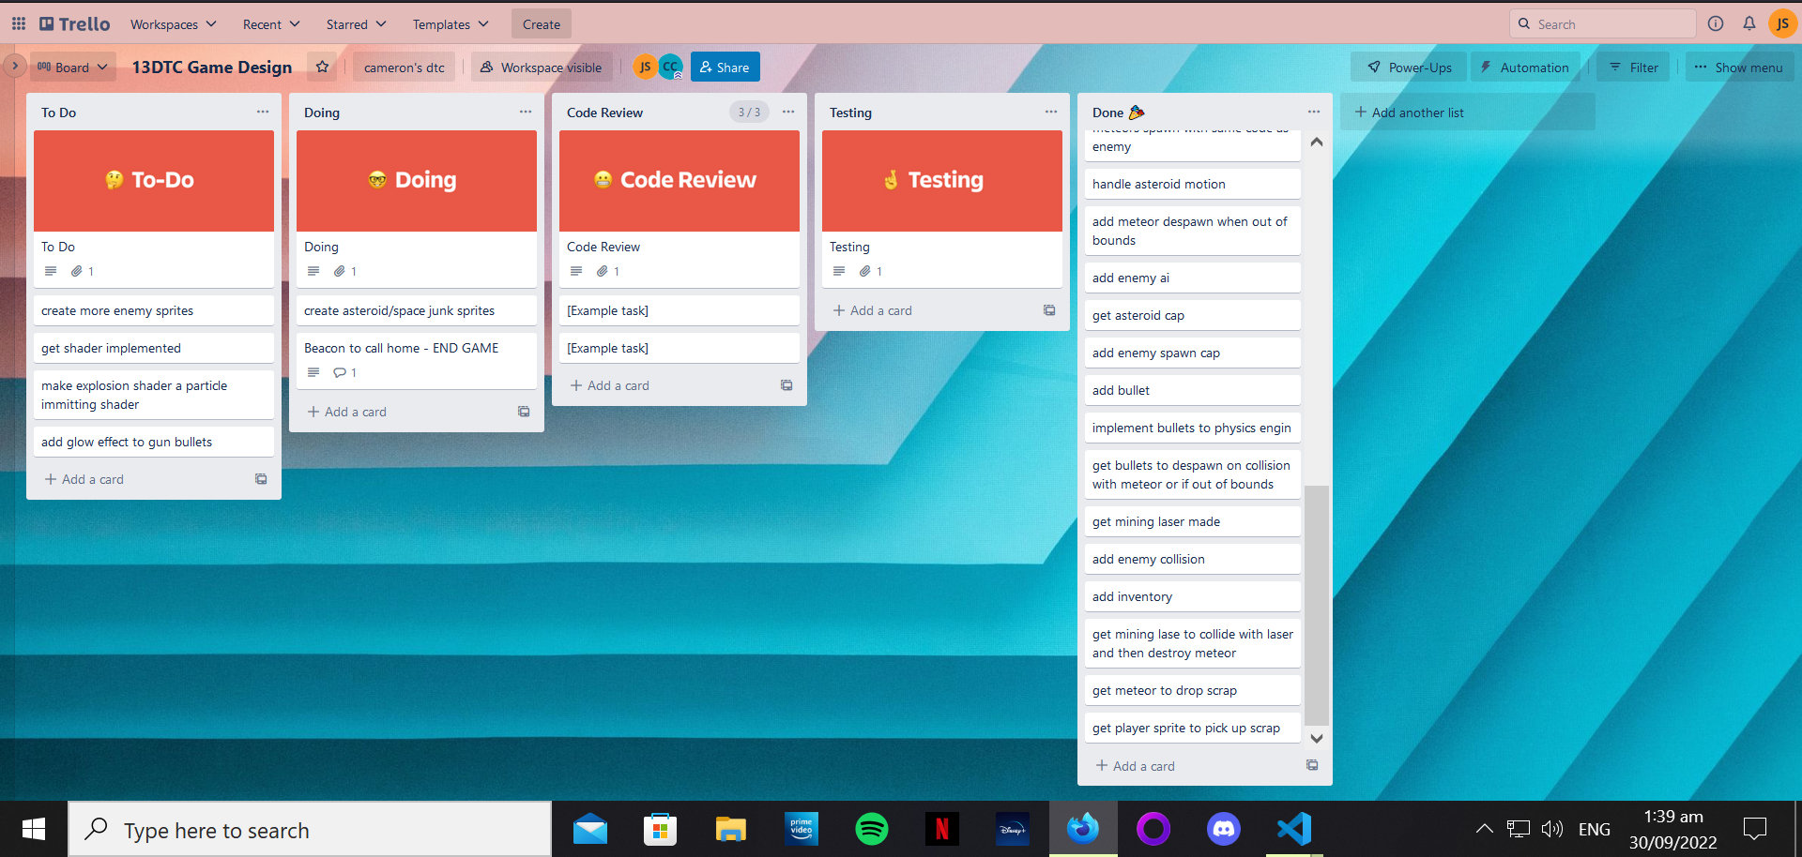
KANBAN board at the end of the sprint

Slide 10
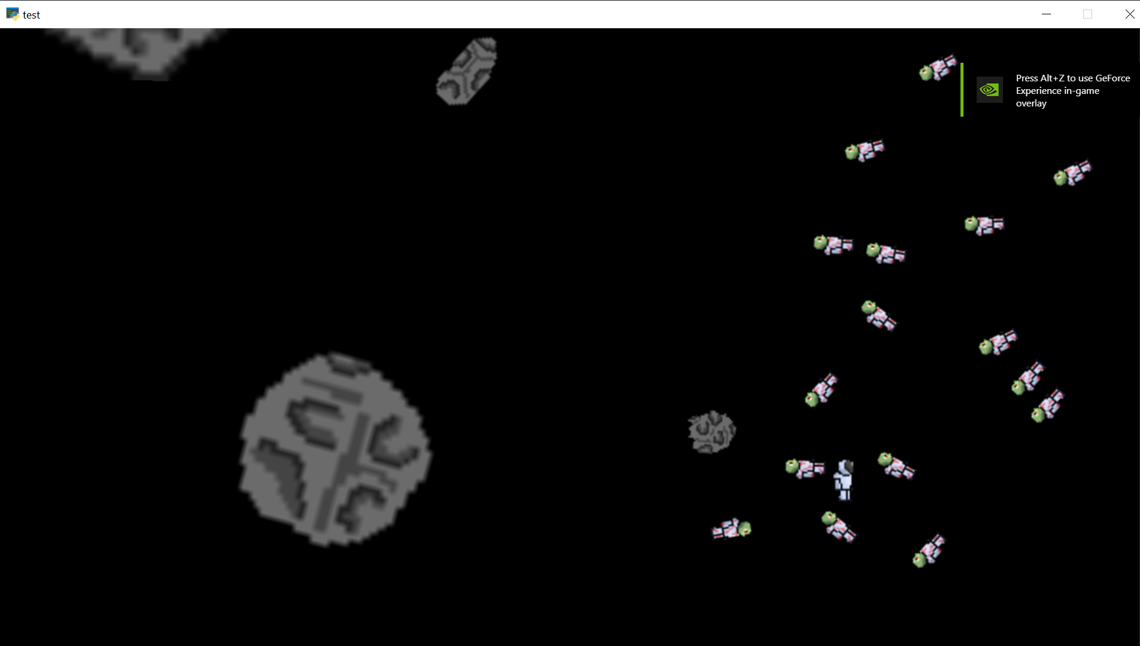
Screenshot of the game at the end of the sprint

Slide 11
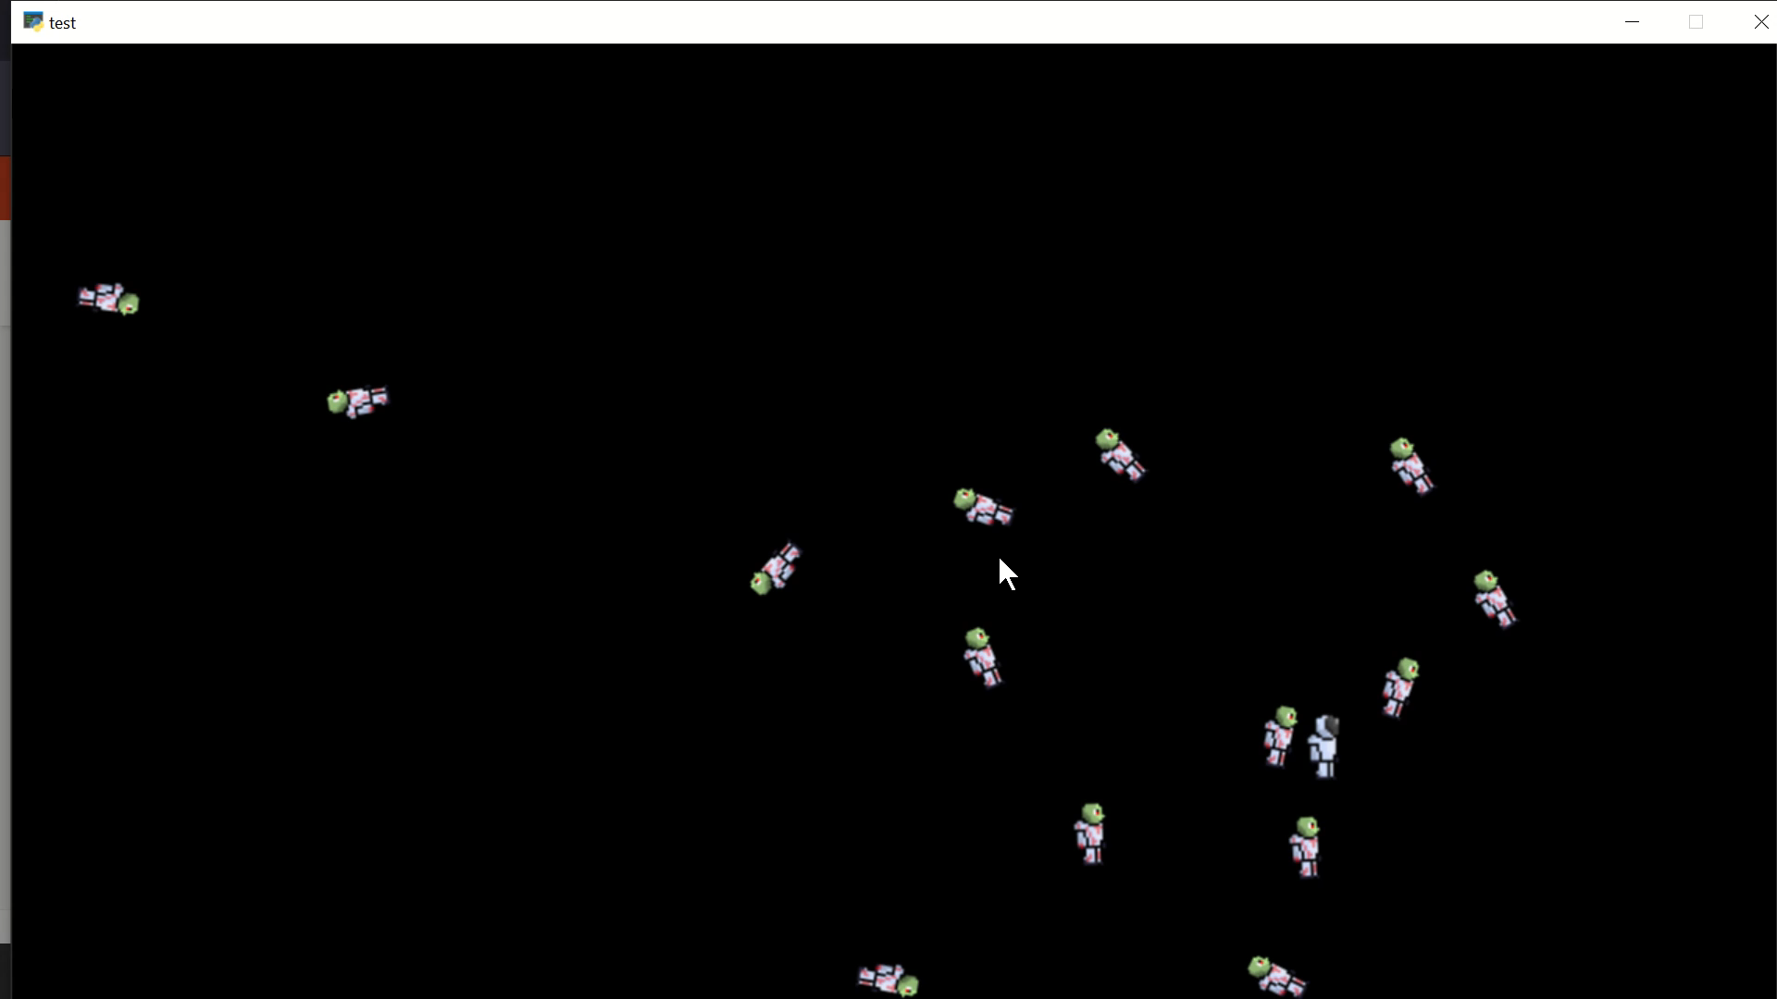
Video of the game at the end of the sprint

Slide 12
Notes for next time, future improvements
This sprint was quite productive and we got alot done, we were added an inventory and the ability to mine asteroids and to kill enemies. For future development i would like to add some sort of shader to the death of the enemy to add more depth to the game and make it more appealing to the end user. We also need to be able to show the picked-up items in the inventory Aswell as being able to craft materials to win the game.

